Slide 1
BITS ZG553: Real Time Systems
K G Krishna
WILP Division, BITS-Pilani, Hyderabad

Slide 2
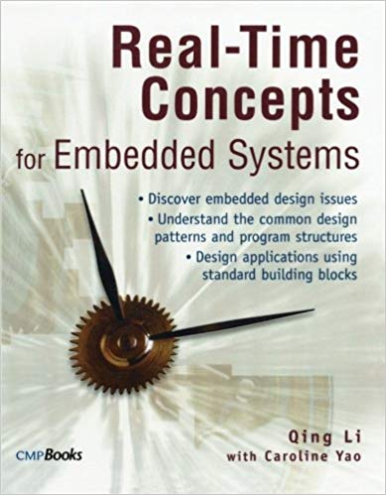
RTS Primer – For Light Reading

Slide 3
L-1a: Real Time Systems -
Overview/Review of OS/RTS Concepts
Note: Students are requested to NOT to rely on PPTs/Recorded sessions as their only source of knowledge, explore sources within your own organization or web for any specific topic; attend classes regularly and involve in discussions;
PLEASE DO NOT PRINT PPTs, Save the Environment!
Source PPT Courtesy: Some of the contents of this PPT is sourced from Presentatoons of Prof K R Anupa, BITS-Pilani WILP Faculty

Slide 4
Performance Criteria for RTS
RT
NRT
Timeliness
Simultaneity
Predictability
Dependability
Throughput
CPU Utilization Factor

Slide 5
Aspects of Dependability
Dependability
Readiness for Usage
Continuity of Service Delivery
Non-occurrence of Catastrophic Consequences
Non-occurrence of unauthorized disclosure of information
Non-occurrence of improper alteration of information
Aptitude to undergo repairs
Available
Reliable
Safe
Confidential
Integral
Maintainable

Slide 6
Worst Case Execution Time
Prediction of execution

Slide 7
Factors that affect execution time
Source Code
Compiler
Hardware
Processor
Memory
I/O
Interconnections
Interrupt Priorities and Latency
Cache
OS

Slide 8
Source Code
Load c
Load b
Multiply
Store into a
Σ₁³ t_{exec} (L_{i})
Σ₁⁴ t_{exec} (L_{1.i})
L1: a = b * c
L2: g = d + e
L3: h = a – f

Slide 9
Loops - while
while (p) do
Q1
Q2
Q3
end while

Slide 10
Loops if then else
if B₁ then
S₁
elseif B₂ then
S₂
elseif B₃ then
S₃
else
S₄
endif
T(B₁) + T(S₁) + T(JMP)
T(B₂) + T(B₁) + T(S₂)+ T(JMP)
T(B₃) + T(B₂) + T(B₁) + T(S₃)+ T(JMP)

Slide 11
The Basics
A Quick Review

Slide 12
What’s an Operating System?
Provides environment for executing programs
Process abstraction for multitasking/concurrency
Scheduling
Hardware abstraction layer (device drivers)
Filesystems
Communication
We will focus on concurrent, real-time issues

Slide 13
Do I Really Need An OS?
Not always
Simplest approach: cyclic executive
loop
do part of task 1
do part of task 2
do part of task 3
end loop

Slide 14
Cyclic Executive
Advantages
Simple implementation
Low overhead
Very predictable
Disadvantages
Can’t handle sporadic events
Everything must operate in lockstep
Code must be scheduled manually

Slide 15
Interrupts
Some events can’t wait for next loop iteration
Communication channels
Transient events
A solution: Cyclic executive plus interrupt routines
Interrupt: environmental event that demands attention
Example: “byte arrived” interrupt on serial channel
Interrupt routine: piece of code executed in response to an interrupt

Slide 16
Handling an Interrupt
1. Normal program execution
3. Processor state saved
4. Interrupt routine runs
2. Interrupt occurs
6. Processor state restored
5. Interrupt routine terminates
7. Normal program execution resumes

Slide 17
Interrupt Service Routines
Most interrupt routines:
Copy peripheral data into a buffer
Indicate to other code that data has arrived
Acknowledge the interrupt (tell hardware)
Longer reaction to interrupt performed outside interrupt routine
E.g., causes a process to start or resume running

Slide 18
Drawbacks of CE + Interrupts
Main loop still running in lockstep
Programmer responsible for scheduling
Scheduling static
Sporadic events handled slowly

Slide 19
Cooperative Multitasking
A cheap alternative
Non-preemptive
Processes responsible for relinquishing control
Examples: Original Windows, Macintosh
A process had to periodically call get_next_event() to let other processes proceed
Drawbacks:
Programmer had to ensure this was called frequently
An errant program would lock up the whole system
Alternative: preemptive multitasking

Slide 20
Concurrency Provided by OS
Basic philosophy:
Let the operating system handle scheduling, and let the programmer handle function
Scheduling and function usually orthogonal
Changing the algorithm would require a change in scheduling.

Slide 21
Batch Operating Systems
Original computers ran in batch mode:
Submit job & its input
Job runs to completion
Collect output
Submit next job
Processor cycles very expensive at the time
Jobs involved reading, writing data to/from tapes
Cycles were being spent waiting for the tape!

Slide 22
Timesharing Operating Systems
Solution
Store multiple batch jobs in memory at once
When one is waiting for the tape, run the other one
Basic idea of timesharing systems
Fairness primary goal of timesharing schedulers
Let no one process consume all the resources
Make sure every process gets “equal” running time

Slide 23
Real-Time Is Not Fair
Main goal of an RTOS scheduler: meeting deadlines
If you have five homework assignments and only one is due in an hour, you work on that one
Fairness does not help you meet deadlines

Slide 24
Role of an OS in Real Time Systems
Standalone Applications
Often no OS involved
Micro controller based Embedded Systems
Some Real Time Applications are huge & complex
Multiple threads
Complicated Synchronization Requirements
Filesystem / Network / Windowing support
OS primitives reduce the software design time

Slide 25
Features of RTOS’s
Scheduling.
Resource Allocation.
Interrupt Handling.
Other issues like kernel size.

Slide 26
Scheduling in RTOS
More information about the tasks are known
No of tasks
Resource Requirements
Release Time
Execution time
Deadlines
Being a more deterministic system better scheduling algorithms can be devised.

Slide 27
RTS - Tasks
Characteristics

Slide 28
Process
A program in execution
An instance of a program running on a computer
The entity that can be assigned to and executed on a processor
A unit of activity characterized by
the execution of a sequence of instructions
a current state
an associated set of system resources
Notes:
28

Slide 29
Process Concept
Process Includes
Program Counter
Code
Data
Stack

Slide 30
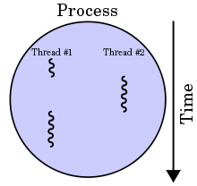
Process & Threads

Slide 31
Multiprogramming
The interleaved execution of two or more computer programs by a single processor
An important technique that
enables a time-sharing system
allows the OS to overlap I/O and computation, creating an efficient system
Notes:
A mode of operation that provides for the interleaved execution of two or more computer programs by a single processor

Slide 32
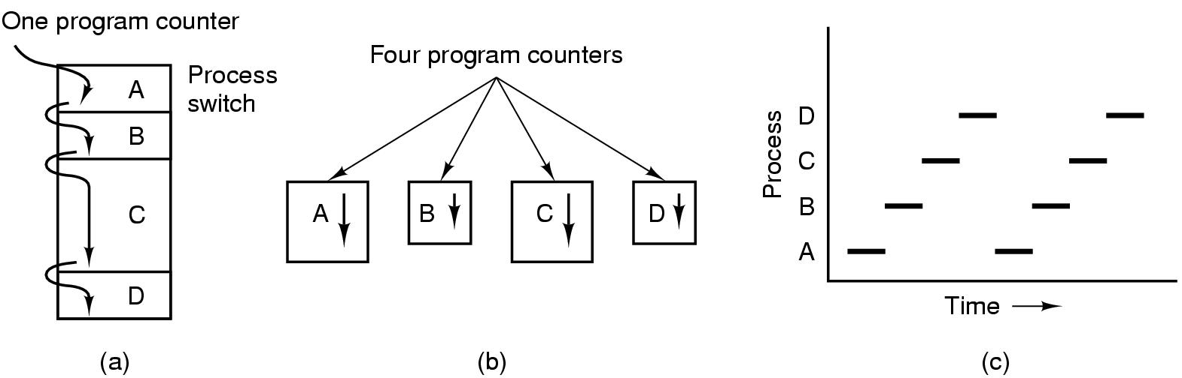
Processes The Process Model
Multiprogramming of four programs
Conceptual model of 4 independent, sequential processes
Only one program active at any instant

Slide 33
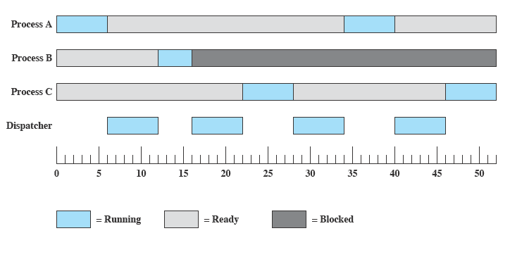
Multiprogramming

Slide 34
Cooperating Processes
Sequential programs consist of a single process
Concurrent applications consist of multiple cooperating processes that execute concurrently
Advantages
Can exploit multiple CPUs (hardware concurrency) for speeding up application

Slide 35
Cooperating Processes
Cooperating processes need to share information
Since each process has its own address space, OS mechanisms are needed to let process exchange information
Two paradigms for cooperating processes
Shared Memory
OS enables two independent processes to have a shared memory segment in their address spaces
Message-passing
OS provides mechanisms for processes to send and receive messages

Slide 36
Threads: Motivation
Process created and managed by the OS kernel
Process creation expensive
Context switching expensive
IPC requires kernel intervention - expensive
Cooperating processes – no need for memory protection, i.e., separate address spaces

Slide 37
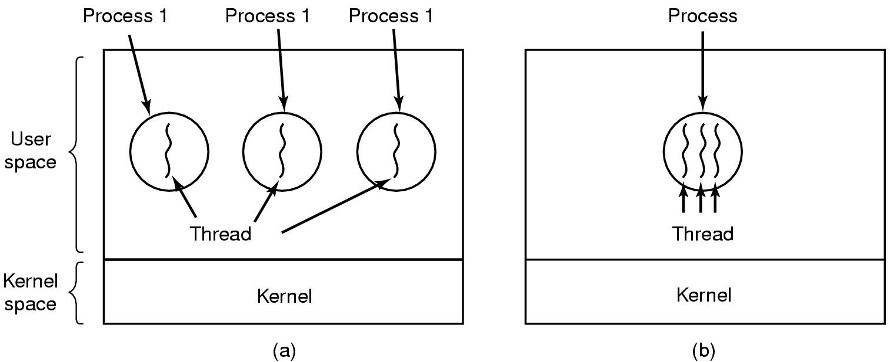
Threads- The Thread Model
(a) Three processes each with one thread
(b) One process with three threads

Slide 38
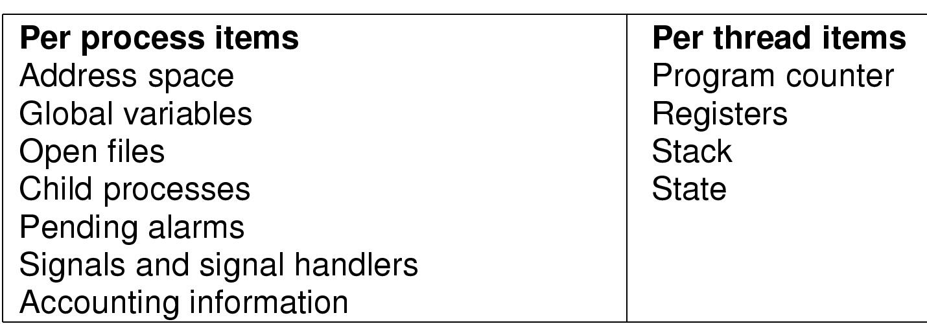
The Thread Model
Items shared by all threads in a process
Items private to each thread

Slide 39
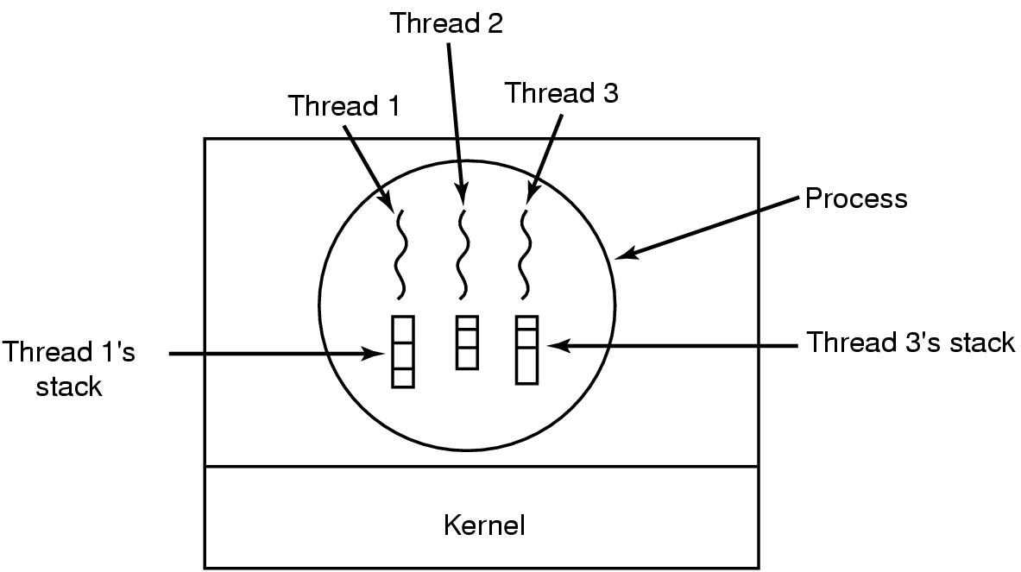
The Thread Model
Each thread has its own stack

Slide 40
Threads/ Process
Similarities
Differences
Share CPU - only one thread active (running) at a time
Threads within a processes execute sequentially.
Can create children.
If one thread is blocked- another thread can run.
Threads are not independent of one another
All threads can access every address in the task
Thread are designed to assist one other- processes might/not – as they originate from different users

Slide 41
Why Threads
Process with multiple threads make a great server - printer server
Threads can share common data - do not need to use inter-process commn
Threads can take advantage of multiprocessors.
Threads are cheap in the sense that
They only need a stack and storage for registers - cheap to create.
Threads use very little resources of OS - they do not need new address space, global data, program code or OS resources.
Context switching fast - only have to save and/or restore PC, SP & regs
But this cheapness does not come free - the biggest drawback is that there is no protection between threads.

Slide 42
Thank You.
Any Questions?

